Slide 1
Branding and Customization
Modern Experience

Slide 3
How to View This Presentation
To switch to Notes Page view:
While in edit mode, click the View tab within the ribbon, and then click Notes Page
To navigate through notes, use the Page Up and Page Down keys
Zoom in or zoom out, if required
In the Notes Page view, you can:
Read any supporting text—now or after the delivery
Add notes to your copy of the presentation, if required
Take the presentation files home with you

Slide 4
Overview
Modern experience
In this Lesson
Hub sites

Slide 5
Objectives
Understand Modern Experience
Discover what Hub Sites are
Learn how to switch from classic to modern

Slide 6
Modern Experience
Available in SharePoint 2019 and SharePoint Online
New user interface for:
Sites (GROUP#0, STS3#0, COMMUNICATION#0)
Lists and Libraries
Site Pages
Mobile Friendly and Responsive
Easier to use
Faster
No more postbacks
All future development from Microsoft only in modern
Notes:
https://blogs.office.com/2016/05/04/the-future-of-sharepoint/
This slide lists advantages of switching to the modern experience. Besides these advantages, be aware that most, if not all, of the future development done by Microsoft with regards to bringing new functionality and features, will be done in the modern experience only.

Slide 7
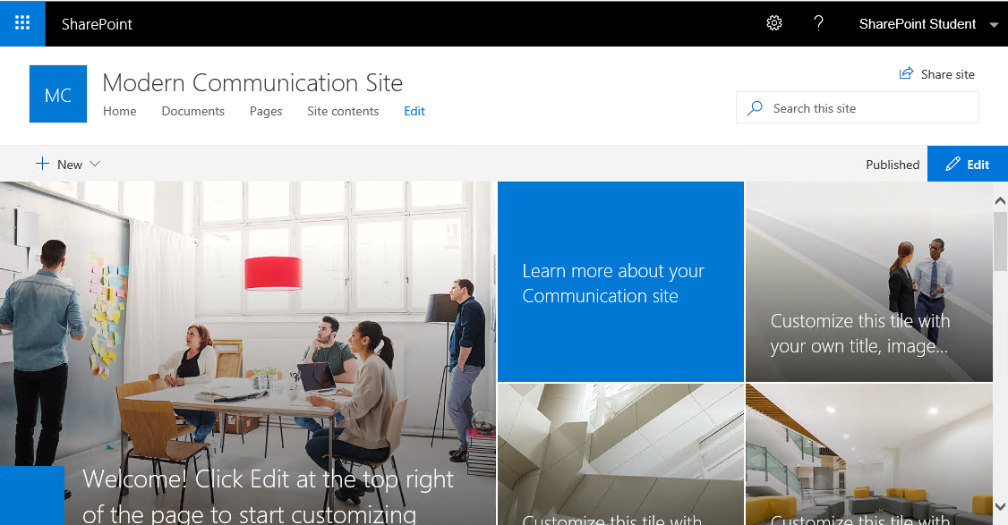
Modern Experience Sample
Modern Communication Site

Slide 8
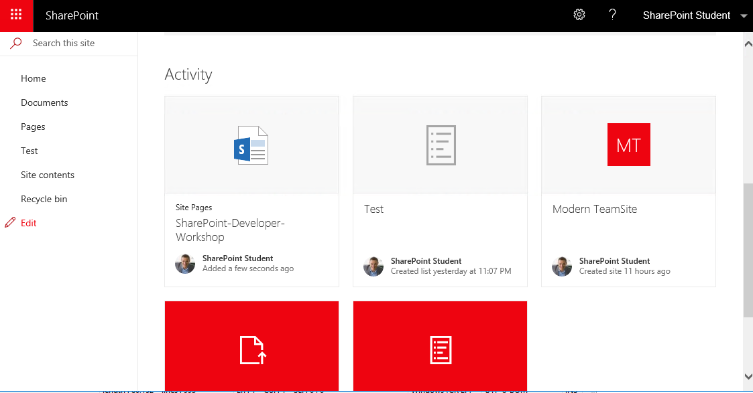
Modern Experience Sample
Modern Team Site

Slide 9
Modern vs. Classic UI
Current Differences
No Ribbon and several actions from the Ribbon not available
Popularity trends, RSS Feed, Connect to Outlook, Open with Access, etc.
No JSLInk or XslLink Support
Some Field Types not available
External data, Publishing Fields (Publishing HTML, Publishing Image, Publishing Hyperlink), BusinessData
No master page or alternate css support
Certain elements cause automatic switch to classic
Unavailable Field Types, limited-access user permission lockdown mode, Document set welcome pages, certain list templates, customizations
https://aka.ms/spo-differences-between-classic-and-modern
Notes:
https://aka.ms/spo-differences-between-classic-and-modern

Slide 10
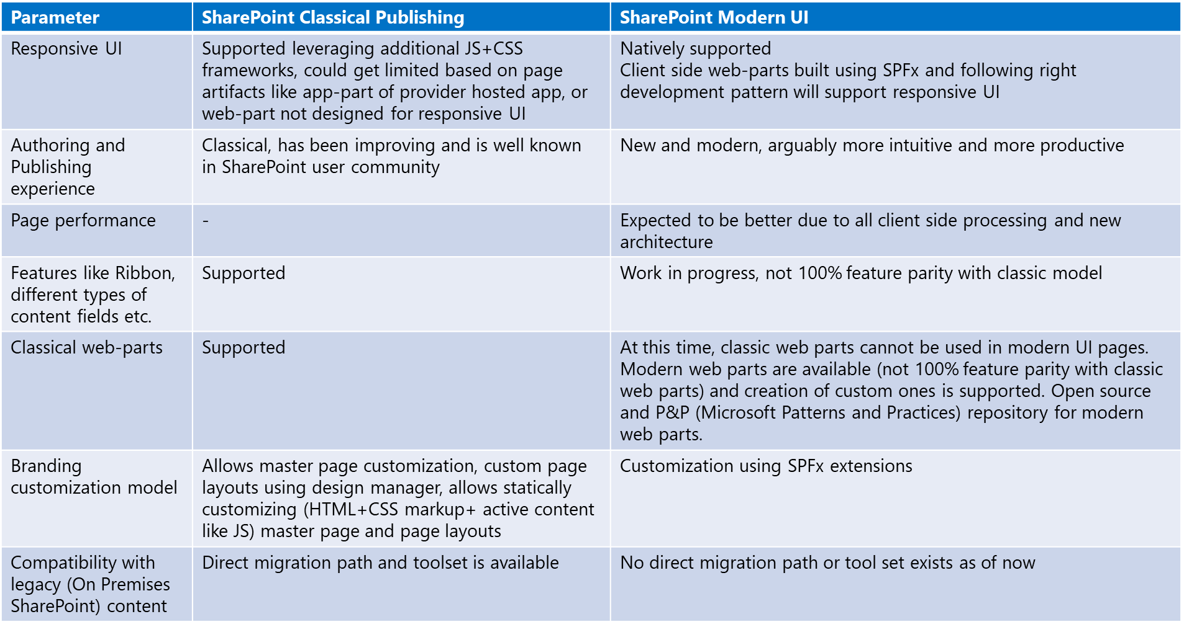
Modern vs. Classic UI
Notes:
https://aka.ms/spo-differences-between-classic-and-modern

Slide 11
Modernize Classic Sites
Learn
Not deprecating ‘classic’ experience, both ‘classic’ and ‘modern’ will coexist
Use modern when possible
Modern controls:
Tenant level list and library experience (only SharePoint 2019, removed from Online)
Site/Web level using PowerShell
Library/List settings
‘Return to classic/modern SharePoint’ link
https://docs.microsoft.com/en-us/sharepoint/dev/transform/modernize-guidance
Notes:
http://aka.ms/sppnp-modernuiscanner
Since Jan. 2017, CSOM has pageRenderType
https://tenantsharepoint.com/_api/web/getfilebyserverrelativeurl('/sites/dwp/Pages/default.aspx')/pageRenderType
0 Undefined = 0, (there's not enough information to know the render mode)
1 MultipeWePart
2 JSLinkCustomization
3 XslLinkCustomization
4 NoSPList
5 HasBusinessDataField
6 HasTaskOutcomeField
7 HasPublishingfield
8 HasGeolocationField
9 HasCustomActionWithCode
10 HasMetadataNavFeature
11 SpecialViewType
12 ListTypeNoSupportForModernMode
13 AnonymousUser
14 ListSettingOff
15 SiteSettingOff
16 WebSettingOff
17 TenantSettingOff
18 CustomizedForm
19 DocLibNewForm
20 UnsupportedFieldTypeInForm
21 InvalidFieldTypeInForm
22 InvalidControModeInForm
23 CustomizedPage
24 ListTemplateNotSupported
100 Modern

Slide 12
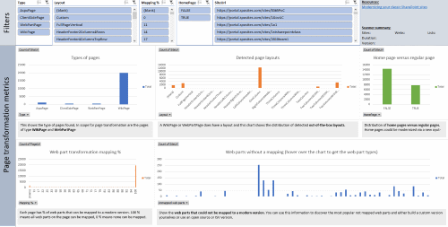
Modernize Classic Sites
Analyze
Use PnP Modern UI or Modernization Scanners to start scanning classic sites
Detects and reports on where work will be needed to transform
https://docs.microsoft.com/en-us/sharepoint/dev/transform/modernize-scanner
Notes:
http://aka.ms/sppnp-modernuiscanner
Since Jan. 2017, CSOM has pageRenderType
https://tenantsharepoint.com/_api/web/getfilebyserverrelativeurl('/sites/dwp/Pages/default.aspx')/pageRenderType
0 Undefined = 0, (there's not enough information to know the render mode)
1 MultipeWePart
2 JSLinkCustomization
3 XslLinkCustomization
4 NoSPList
5 HasBusinessDataField
6 HasTaskOutcomeField
7 HasPublishingfield
8 HasGeolocationField
9 HasCustomActionWithCode
10 HasMetadataNavFeature
11 SpecialViewType
12 ListTypeNoSupportForModernMode
13 AnonymousUser
14 ListSettingOff
15 SiteSettingOff
16 WebSettingOff
17 TenantSettingOff
18 CustomizedForm
19 DocLibNewForm
20 UnsupportedFieldTypeInForm
21 InvalidFieldTypeInForm
22 InvalidControModeInForm
23 CustomizedPage
24 ListTemplateNotSupported
100 Modern

Slide 13
Modernize Classic Sites
Modernize
Start replacing customizations to work with modern
Replace JSLink, first party web parts not available, custom actions and list commands with SPFx web parts or extensions
Enable modern for lists and libraries
Connect your site to Office 365 Group a.k.a. ‘Groupify’
Create modern client-side pages
Provide communication and optional training to end-users
https://docs.microsoft.com/en-us/sharepoint/dev/transform/modernize-userinterface
Notes:
If you’re going to modernize your sites and pages, you typically go through the components an steps shown on this slide.

Slide 14
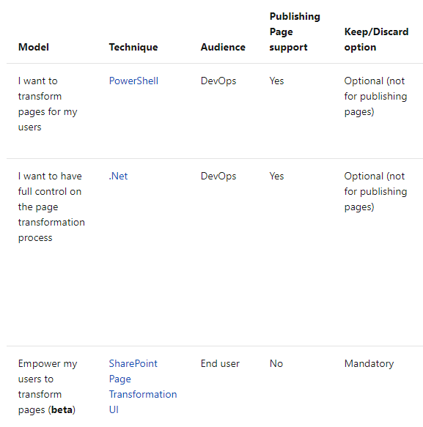
Modernize Classic Sites
Migration Tools
PowerShell
Easiest but more restricted upgrade process
.NET
Fully customizable upgrade process
Transformation web UI
Puts the end user in control
https://docs.microsoft.com/en-us/sharepoint/dev/transform/modernize-userinterface-site-pages
Notes:
There are various community tools available for aiding in the modernization process. Depending on the desired control and availability to skilled resources, you may choose from the three options shown on this slide.
Alternatively, especially in a smaller environment, you could also choose to manually upgrade your environment by creating Site Pages for every existing page and decorating them at will.

Slide 15
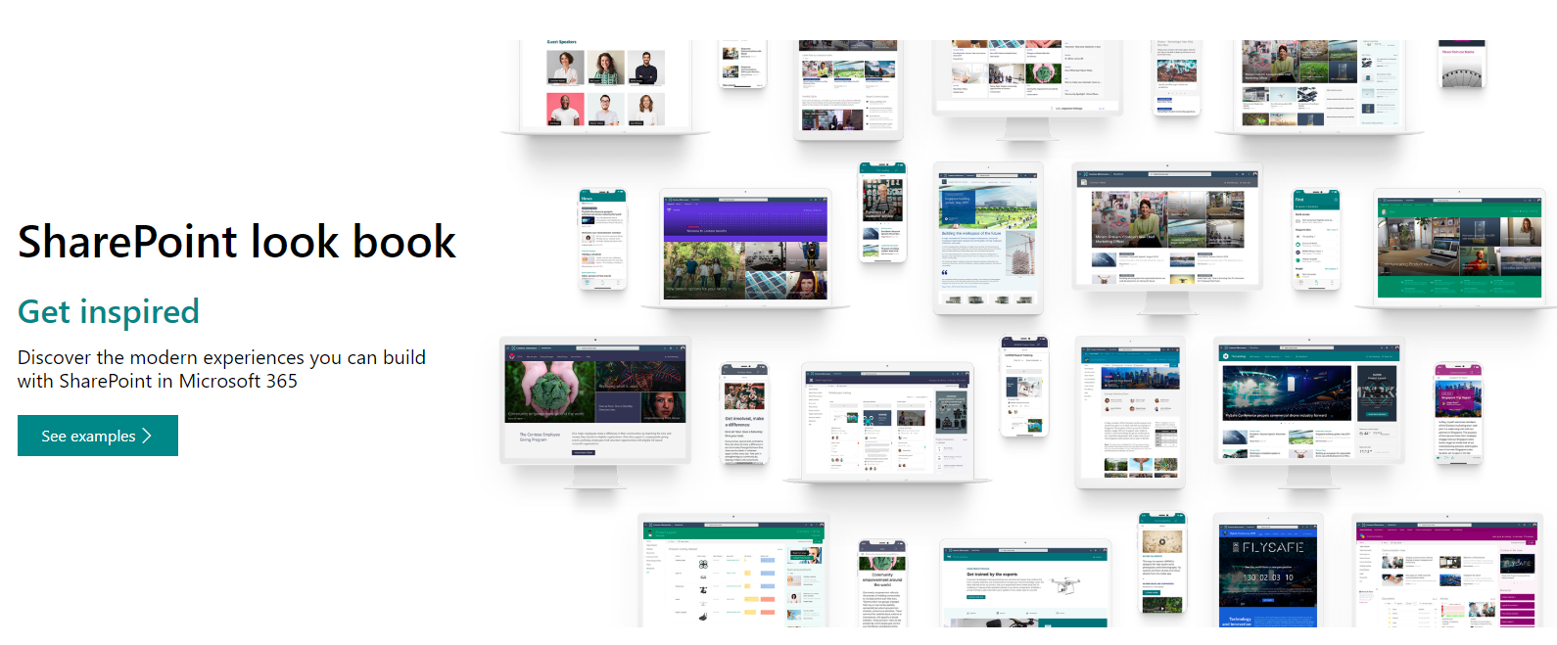
SharePoint look book
Provides inspiration and samples for a Modern Experience
https://lookbook.microsoft.com/
Notes:
The SharePoint look book website can provide you with samples of how to decorate and set up the modern experience in SharePoint Online. It can function as a great starting point in your discussions with the Public Relations department of your organization on how your new modern intranet could be looking like.

Slide 16
Hub Sites
Only for SharePoint Online, not for SharePoint On-Premises
SharePoint Online has a flat architecture with many site collections
Hubs connect site collections in a 1 to many relationship
Hub cannot be connected to another hub yet*
Flexible by design; can be dissociated and re-associated by site owner through UI for modern sites or programmatically
Hubs are identified by SharePoint Online Administrators and can be permission scoped
Hubs will share common elements with associate sites
Global navigation
Applied theme upon association
Roll up news and activity
Scoped search
Notes:
https://techcommunity.microsoft.com/t5/SharePoint-Blog/SharePoint-hub-sites-new-in-Office-365/ba-p/109547
*Nested hubs will come to SharePoint Online some time in 2020.

Slide 17
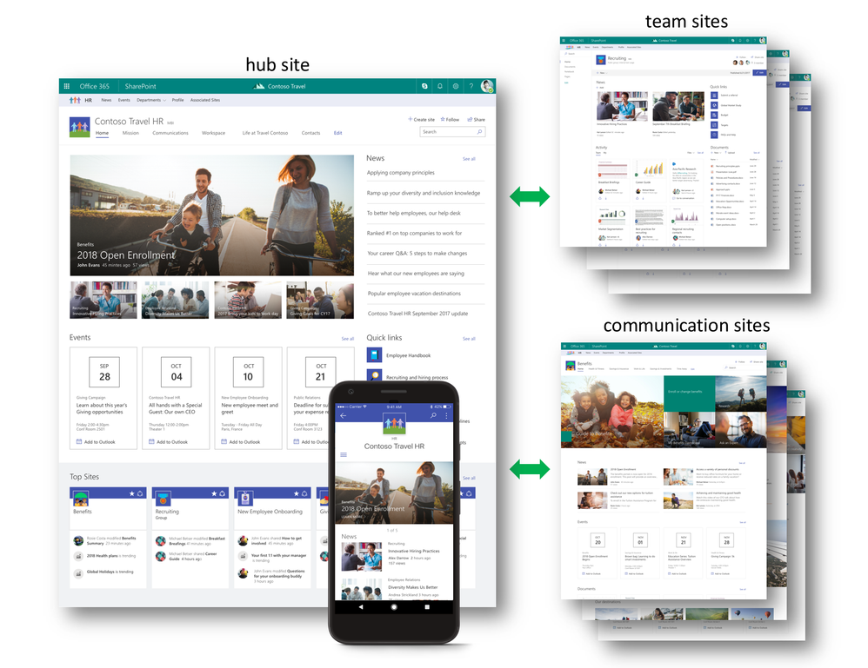
Hub Sites Sample

Slide 18
Knowledge Check
At the tenant level (SharePoint 2019 only), site collection, web level, and list/library level
At which levels can you control the rendering of Lists and Libraries in modern or classic?
Can Hub Sites be associated to other Hub Sites?
Not yet, will come to SharePoint Online later in 2020
What are some advantages of switching to the modern experience?
Faster
Response
Suited for devices with various screen sizes
All new features by Microsoft will be released in modern only

Slide 19
Lesson Summary
Modern experience
Hub Sites
Migrating from classic to modern

Slide 20
Questions?

